Slide 1
FAULT DETECTION IN STREET LIGHTs AND ELECTRICITY THEFT DETECTION
PRESENTED BY DATAGINEERS

Slide 2
Challenges we are adDressing
FAULT DETECTION
1st GEN: Probability of lights being faulty in a CCSM-ID.
2ndGEN: Prediction of the no. of days a street light will become faulty in future.
THEFT DETECTION
We are trying to predict the theft in the transmisson lines using the DCSMA algorithm.
CUSTOMER SATISFACTION

Slide 3
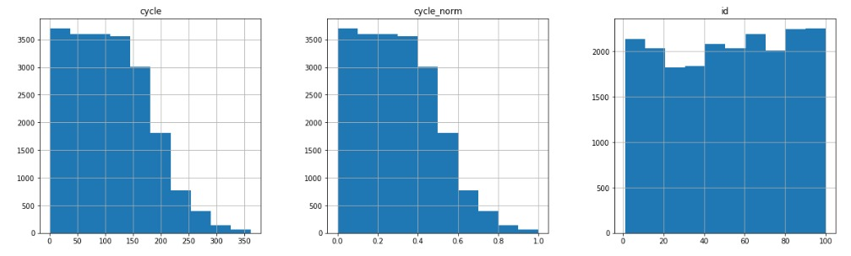
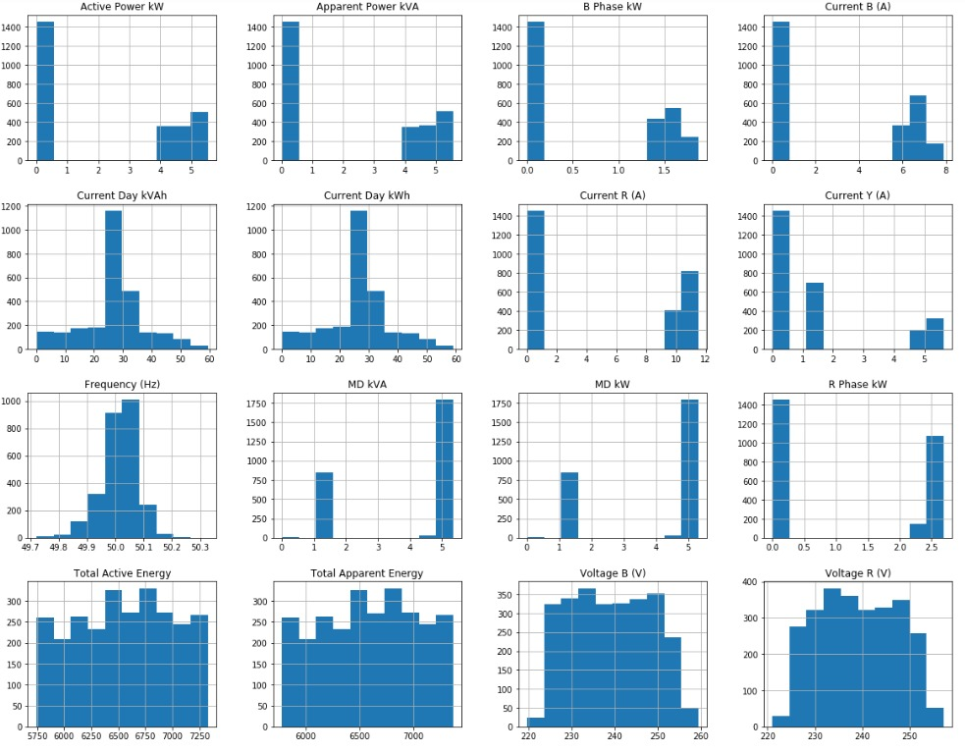
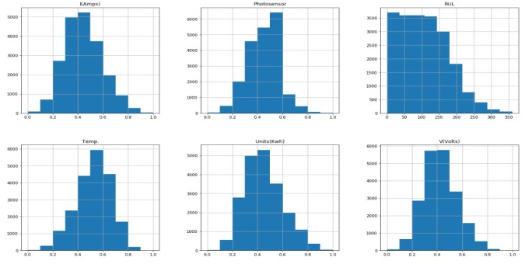
DATA ITSELF SPEAKS
What We Observed from the data ?
Most of the data set was following normal distribution.
The data was not appropriate enough to predict the faulty lights.
Some of the important data was missing from the sets.

Slide 4
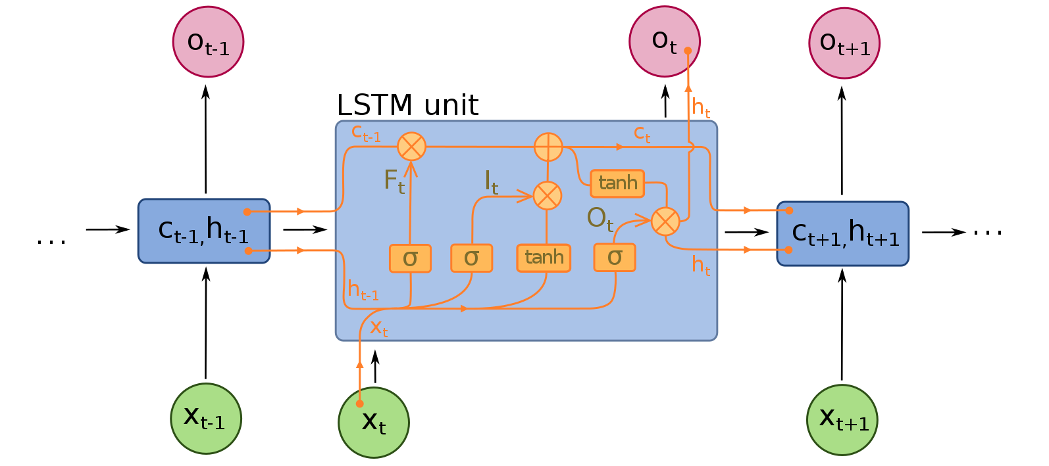
Our APPROACH
FAULT DETECTION
We are trying to implement LSTM model to predict the No. of days in which the lamp will go out of order. LSTM model uses past 5 data and predicts the output with respect to that data.
LSTM(LONG SHORT TERM MEMORY)

Slide 5
CODE INSIGHTS AND CSV
We considered last 5 data along with taking the following parameters:
I(Amps)
V(Load)
Power(KWh)
Temp.
Photo sensor
Cycle – life span of lamp
Provided data
Collected value

Slide 6
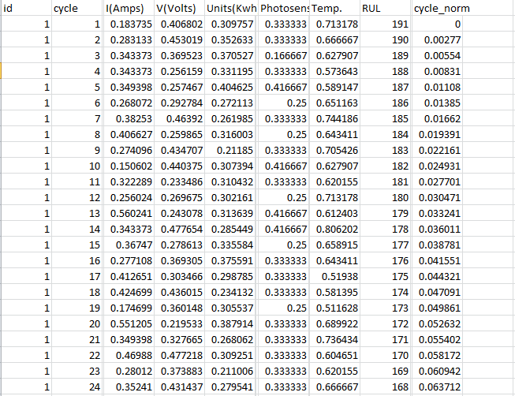
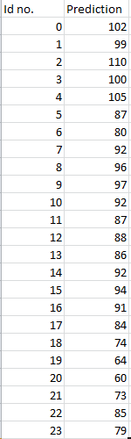
Data sets and predictions
A snippet of data set and predicted model
A snippet of the predicted model and clusters.

Slide 7
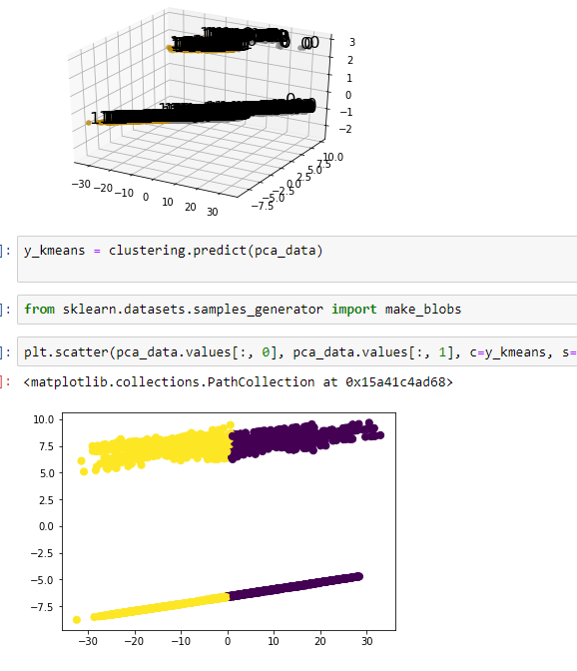
CLUSTER PREDICTION FOR THEFT
DBSCAN Algorithm referred IEEE paper for this.

